Slide 1
First presentation of oop

Slide 2
Uml class diagram
Introduction of UML Class Diagram
Inheritance In Class Diagram
Basic UML Diagram
Types of Inheritance with class diagram
Final tips & takeaways

Slide 3

Introduction to uml class diagrams

Slide 4
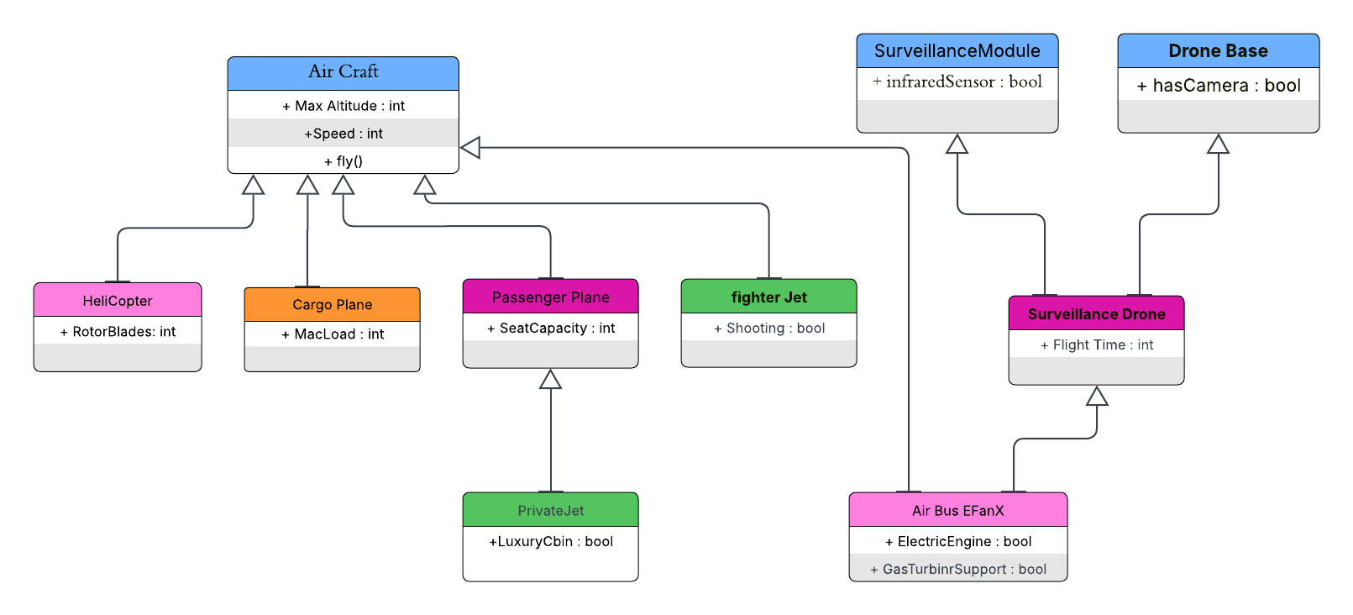
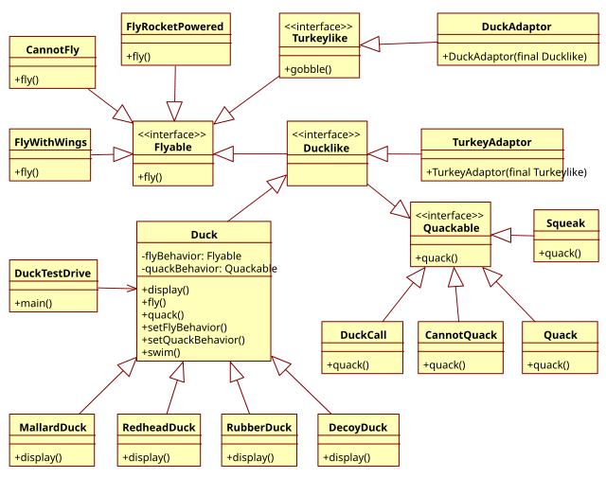
What is UML Class Diagram?
The UML Class diagram is a graphical notation used to construct and visualize object-oriented systems.
This Photo by Unknown Author is licensed under CC BY-SA

Slide 5
Inheritance in Class Diagrams
The essence of inheritance can be observed through the relationships between a superclass (also known as the parent class) and subclass (or child class). A superclass is a general category that outlines common attributes and methods, which are then inherited by the more specialized subclasses. This mechanism not only fosters code reuse—eliminating redundancy by allowing subclasses to utilize and extend the functionality of their super classes—but also establishes a natural hierarchy within the system's architecture.

Slide 6

basic uml diagram
Air Craft

Slide 7
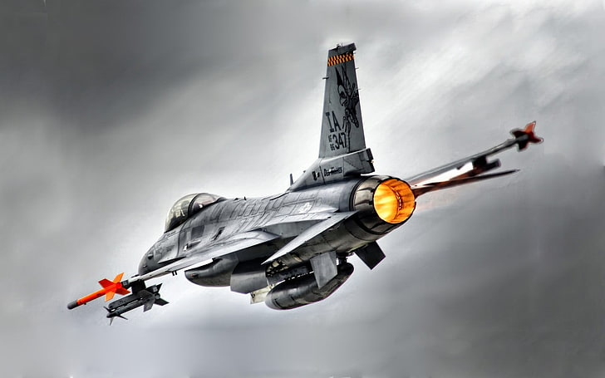
Base Class: Aircraft ✈️
This is the most general class, representing any type of flying vehicle.
Attributes:
maxAltitude: Maximum flying height.
speed: Cruising or top speed.
Method:
fly(): A general behavior all aircraft must support.
All aircraft types inherit these properties. If you create ohter objects, they will automatically have maxAltitude, speed, and fly().

Slide 8
Types of Inheritance with class diagram
🔹 A. Single Inheritance
Aircraft → Helicopter
Helicopter inherits from Aircraft:
Inherits: maxAltitude, speed, fly()
Adds: rotorBlades
So, a Helicopter has the base flying features plus details specific to rotary-wing aircraft.
/
/

Slide 9
Types of Inheritance with class diagram
🔹 B. Hierarchical Inheritance
Multiple classes inherit from a single parent.
PassengerPlane, CargoPlane, and FighterJet all inherit from Aircraft.
Each subclass adds specialized attributes:
PassengerPlane: seatCapacity
CargoPlane: maxLoadKg
FighterJet: stealthCapable
All of them share:
maxAltitude, speed, fly() from Aircraft

Slide 10





Types of Inheritance with class diagram
🔹 C. Multilevel Inheritance
Aircraft → PassengerPlane → PrivateJet
PrivateJet inherits everything from PassengerPlane, which already inherits from Aircraft.
So it gets:
seatCapacity from PassengerPlane
maxAltitude, speed, and fly() from Aircraft
Adds: hasLuxuryCabin

Slide 11
Types of Inheritance with class diagram
🔹 D. Multiple Inheritance
SurveillanceDrone inherits from both DroneBase and SurveillanceModule
From DroneBase: hasCamera
From SurveillanceModule: infraredSensor
Adds: flightTime
Real drones often combine different technologies, so this simulates how multiple capabilities (camera, sensors) come together.

Slide 12
Types of Inheritance with class diagram
🔹 E. Hybrid Inheritance
AirbusEFanX inherits from both Aircraft and DroneBase
From Aircraft: fly(), speed, maxAltitude
From DroneBase: hasCamera
Adds: electricEngine, gasTurbineSupport
This hybrid aircraft combines traditional flight and drone-like features (surveillance, autonomy). Airbus E-Fan X was a real hybrid-electric prototype aircraft, mixing gas turbines with electric motors.

Slide 13
Summary Table of Classes
Class Name | Inherits From | Extra Attributes
Helicopter | Aircraft | rotorBlades
PassengerPlane | Aircraft | seatCapacity
PrivateJet | PassengerPlane | luxuryCabin
SurveillanceDrone | DroneBase+SurvillanceModule | flightTime
AirbusE FanX | Aircraft+DroneBase | electricEngine, gas terbineSupport

Slide 14

Thank you
Saqlain Mushtaq
2024-SE-35
Saqlainmushtaq.se.2428@gmail.com
https://github.com/SaqlainMushtaq590/OPP-works/tree/main/Presantation

